Slide 1

Java Security
Dima Ionut Daniel

Slide 2
Contents
What is Java?
History
Java Security
Security Manager
Access Controller
Class Loader
Cryptography
Keys and Certificates
Message Digests
Cipher Encryption
SSL and HTTPS
JAAS
Bibliography

Slide 3

What is Java?
Java is a programming language created by Sun Microsystems.
Java is used in a wide variety of computing platforms from embedded devices and mobile phones on the low end, to enterprise servers and supercomputers on the high end.
Java eliminates certain low-level constructs such as pointers and has a very simple memory model where every object is allocated on the heap and all variables of object types are references.
Memory management is handled through integrated automatic garbage collection performed by the JVM.

Slide 4
What is Java? (cont.)
The heart of the Java platform is the concept of a "virtual machine" that executes Java bytecode programs. This bytecode is the same no matter what hardware or operating system the program is running under.
There is a JIT(Just-In-Time) compiler within the Java Virtual Machine, or JVM. The JIT compiler translates the Java bytecode into native processor instructions at run-time and caches the native code in memory during execution. The use of a JIT compiler means that Java applications, after a short delay during loading and once they have "warmed up" by being all or mostly JIT-compiled, tend to run about as fast as native programs.
The Java programs are cross-platform or platform independent, but the code of the Java Virtual Machines (JVM) that execute these programs is not.

Slide 5
History
The initial Java release was named Oak, and the first stable version was JDK 1.0.2, called Java 1.
JDK 1.0 - 23 January 1996
JDK 1.1 – 19 February 1997
J2SE 1.2 – 8 December 1998 (codename Playground)
J2SE 1.3 – 8 May 2000 (codename Kestrel)
J2SE 1.4 – 6 February 2002 (codename Merlin)
J2SE 5.0 – 30 September 2004 (codename Tiger)
Java SE 6 – 11 December 2006 (codename Mustang)
Java SE 7 – 7 July 2011(codename Dolphin)
Java SE 8 – 18 March 2014 (codename Spider)
Java SE 9 – planned for 2016

Slide 6
Java Security
Java has the following security extensions:
Java Cryptography Extension(JCE) version 1.2.1
Java Secure Sockets Extension (JSSE) version 1.0.2
Java Authentication and Authorization Service (JAAS) version 1.0.

Slide 7
Java Security (cont.)
JCE:
Encryption (Ciphers)
Secure Key Exchange
Secure Message Digests
An alternate key management system

Slide 8
Java Security (cont.)
JCE consists in 4 jar files:
US_export_policy.jar (jre/lib/security)
jce1_2_1.jar (jre/lib)
local_policy.jar (jre/lib/security)
sunjce_provider.jar (jre/lib/ext)

Slide 9
Java Security (cont.)
JSSE provides SSL encryption facilities and consists in jsse.jar jar file.
JAAS provides authentication and authorization.
It contains a Java library which defines the interface of the service and platform-specific modules to perform the authorization (the JAAS modules).

Slide 10
Java Security (cont.)
Java security elements:
The bytecode verifier ensures that Java class files follow the rules of the Java language.
In terms of resources, the bytecode verifier helps enforce memory protections for all Java programs.
The class loader can set permissions for each class it loads.
The access controller allows (or prevents) most access from the core API to the operating system, based upon policies set by the end user or system administrator.
The security manager is the primary interface between the core API and the operating system; it has the ultimate responsibility for allowing or preventing access to all system resources.
The security package allows to add security features to the application as well as providing the basis by which Java classes may be signed.

Slide 11
Java Security (cont.)
The Java security packages include debugging code that you can enable via a system property.
The property used is java.security.debug:
all: turn on all debugging options.
access: trace all calls to the checkPermission() method of the access controller with bellow sub-options.
stack: dumps stack every time permission is checked.
failure: dumps stack when permission is denied.
domain: dumps protection domain in force when a protection is checked.

Slide 12
Java Security (cont.)
jar: when processing a signed jar file, print the signatures of the file, the certificates, and classes to which they apply.
policy: print information about policy files as they are parsed .
scl: print information about the permissions granted directly by a secure class loader.
These options should be given as a comma-separated list: -Djava.security.debug=scl,access,failure.

Slide 13
Java Security (cont.)
JSSE uses the javax.net.debug with following options:
all: turn on all options and sub-options.
ssl: turn on SSL debuging; it contains bellow sub-options:
record: prints a trace of each SSL record
handshake: prints each handshake message as it is received.
keygen: prints key generation data for the secret key exchange.
session: prints SSL session activity.
defaultctx: prints the default SSL initialization information.
sslctx: prints information about the SSL context.
sessioncache: prints information about SSL session cache.

Slide 14
Java Security (cont.)
keymanager: prints information about calls to the key manager.
trustmanager: prints information about calls to the trust manager.
data: for handshake tracing, print out a hex dump of each message.
verbose: for handshake tracing, print out verbose information.
plaintext: for record tracing, print out a hex dump of the record.

Slide 15
Java Security (cont.)
Elements of Java Sandbox:
A permission is a specific action that code is allowed to perform.
Permissions contains 3 elements: type, name, actions.
A file permission may specify that a particular file can be read, written, deleted, or some combination of those actions.
Example:
permission java.security.AllPermission;
permission java.lang.RuntimePermission "stopThread";
permission java.io.FilePermission "/tmp/foo", "read";

Slide 16
Java Security (cont.)
Code sources are the location from which a class has been loaded along with information about who signed the class, if applicable.
The location is specified as a URL, which follows standard Java practice:
from the file system through a file-based URL
from the network via a network-based URL.
If code is signed, information about the signer is included in the code source.
The URL within a code source is called a codebase.
A protection domain is an association of permissions with a particular code source.
Protection domains are the basic concept of the default sandbox.

Slide 17
Java Security (cont.)
Policy files are the administrative element that controls the sandbox.
A policy file contains one or more entries that define a protection domain.
Programs vary in the way in which they define policy files:
a global policy file that all instances of the virtual machine
a user-specific policy file.
Policy files are simple files that can be created and modified with a text editor, and the JRE comes with a tool (policytool) that allows them to be administered.

Slide 18
Java Security (cont.)
Signed code depends on public key certificates.
The certificates are held in a location (usually a file) called the keystore.
Many parameters of the default sandbox are controlled by entries in the java.security file.
policy.expandProperties=true
policy.allowSystemProperty=true
policy.url.1=file:${java.home}/lib/security/java.policy
policy.url.2=file:${user.home}/.java.policy

Slide 19
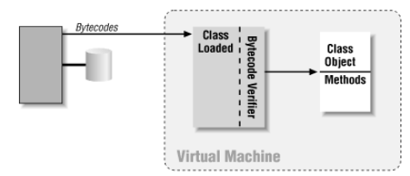
Java Security (cont.)
The bytecode verifier is an internal part of the Java virtual machine and has no interface:
The programmers cannot access it and users cannot interact with it.
The verifier automatically examines the bytecodes as they are built into class objects by the class loader of the virtual machine.

Slide 20
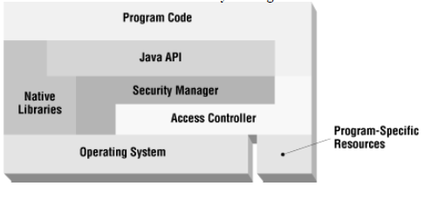
Security Manager
The security manager provides the mechanism that the Java API uses to see if security-related operations are allowed.
The purpose of the security manager is to determine whether particular operations should be permitted or denied.

Slide 21
Security Manager (cont.)
The security manager is used only if it is explicitly installed.
When we run a Java application, we need to specify the -Djava.security.manager option installs a security manager.
The security manager is installed programmatically by the appletviewer and the Java Plug-in.

Slide 22
Access Controller
The implementation of most security managers is based entirely upon the access controller.
The access controller is built upon the four concepts:
Code sources: encapsulation of the location from which certain Java classes were obtained.
Permissions: encapsulation of a request to perform a particular operation.
Policies: encapsulation of all the specific permissions that should be granted to specific code sources.
Protection domains: encapsulation of a particular code source and the permissions granted to that code source.

Slide 23
Access Controller (cont.)
The CodeSource class is a simple object that reflects the URL from which a class was loaded and the keys (if any) that were used to sign that class.
Class loaders are responsible for creating and manipulating code source objects.
The basic entity that the access controller operates on is a permission object: instance of the Permission class (java.security.Permission).
The Permission class itself is an abstract class that represents a particular operation.
When it is associated with a class (through a code source and a protection domain), a permission object represents an actual permission that has been granted to that class.
A permission object allows us to ask if we have a specific permission.

Slide 24
Access Controller (cont.)
The Policy class (java.security.Policy) encapsulates a mapping between code sources and permission objects.
If we need to use custom Policy classes we need either to embed the custom policy class into rt.jar or we must run the virtual machine with the appropriate argument to specify the boot classpath.
java -Xbootclasspath:/files/policy ...other args...

Slide 25
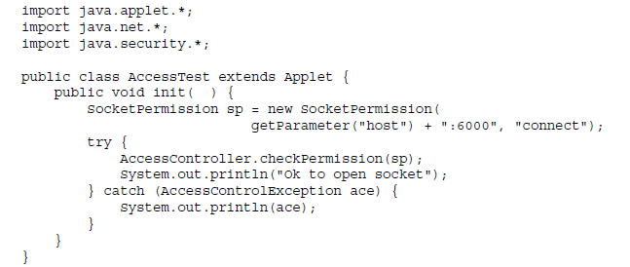
Access Controller (cont.)
A protection domain is a grouping of a code source and permissions.
A protection domain represents all the permissions that are granted to a particular code source.
A protection domain is an instance of the ProtectionDomain class (java.security.ProtectionDomain).
The access controller is represented by the java.security.AccessController class.

Slide 26
Access Controller (cont.)
The access controller works by examining the protection domains of every class on the stack.
Using java.security.AccessControlContext class we can examine the protection domains of a different set of classes.
Instances of this class are returned by the getContext( ) method of the AccessController class.
That method takes a snapshot of the protection domains that are on the stack when it is called and stores those domains into the returned access context object.
The notion of permissions and the access controller can be encapsulated into a single object: a guarded object, which is implemented by the GuardedObject class (java.security.GuardedObject).

Slide 27
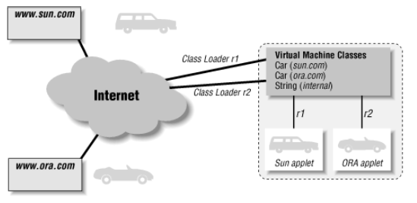
Class Loader
Class loaders are the mechanism by which files (or other sources) containing Java bytecodes are read into the Java virtual machine and converted into class definitions.
There are three areas in which the class loader operates with the security model.
cooperates with the virtual machine to define namespaces, which protect the integrity of the security features built into the Java language.
calls the security manager when appropriate, ensuring that code has the appropriate permissions in order to access or define classes.
sets up the mapping of permissions to class objects (the protection domain of each class) so that the access controller knows which classes have which permissions.

Slide 28
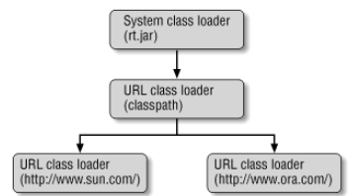
Class Loader (cont.)
Class loaders are organized into a tree hierarchy and at the root of this tree is the system class loader.
This class loader is also called the primordial class loader or the null class loader.
It is used only to load classes from the core Java API.
The system class loader has one or more children.

Slide 29
Class Loader (cont.)
The hierarchy comes into play when it is time to load a class.
Classes are loaded in one of three ways:
explicitly by calling the loadClass( ) method of a class loader
explicitly by calling the Class.forName( ) method,
implicitly when they are referenced by an already-loaded class.

Slide 30
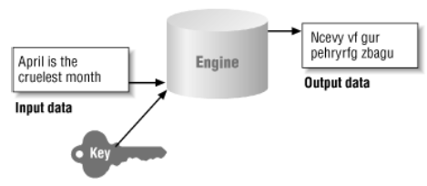
Cryptography
We need to secure the packages and we need to authenticate classes that are loaded from network.
The cryptograpghic engine takes some input data and some sort of key and produces a set of output data.
There are engines that don't require a key as part of their input.
In the Java security package there are 2 standard cryptographic engines:
- message digest engine
- digital signature engine

Slide 31
Cryptography (cont.)
Keys are the basic for many cryptographic operations.
A key is a long string of numbers that have very strict mathematical properties.
In the realm of cryptography, keys can either come alone (secret keys) or in pairs.
A key pair has 2 keys: public and private key.

Slide 32
Cryptography (cont.)
When an algorithm requires a secret key, both parties using the algorithm will use the same key.
Both parties must agree to keep the secret key.
Public and private keys can provide asymmetric operation o cryptographic engines.
The public key can be used by one party participating in the algorithm and the private key can be used by the other party.
So we use the public key to encrypt the data and the private key to decrypt it.

Slide 33
Cryptography (cont.)
A message digest is a small sequence of bytes that is produced when given set of data is passed through the message digest engine.
A message digest engine doesn't always require a key to operate.
The message digest engine takes a single stream of data as its input and produces a single output.
The result is called digest or hash.

Slide 34
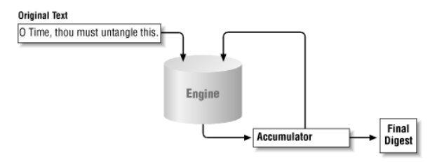
Cryptography (cont.)
If we need to determine whether a particular digest represents a particular set of data we need to recalculate the digest and compare the newly calculated digest with the original digest.
The digest algorithm has an internal accumulator that operates on all data fed into the engine.

Slide 35
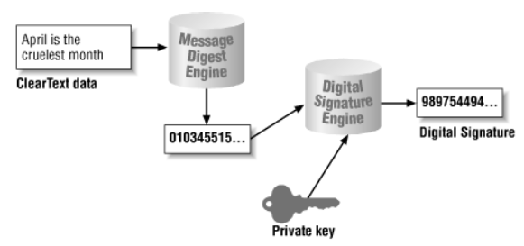
Cryptography (cont.)
The primary engine in the security package is the digital signature engine.
Digital signatures rely on 2 things:
ability to generate a message digest
ability to encrypt the digest

Slide 36
Cryptography (cont.)
The engines are part of the Java Cryptography Extension (JCE) and the Java Secure Socket Extension (JSSE).
The engines in Java that provide the digital signature, message digests are provided in a set of abstract classes in the Java security package.
A message digest can implement a particular algorithm such as MD5 or SHA.

Slide 37
Cryptography (cont.)
The java.security.Provider class forms the basis of the security provider architecture.
The default provider class that comes with Sun's implementation is the sun.security.provider.Sun class.
The java.security.Security class is responsible for managing the set of provider classes.

Slide 38
Keys and Certificates
Keys are required to create and verify digital signature or to perform encryption.
There are 2 types of keys: asymmetric and symmetric.
Asymmetric keys are of 2 types: public and private.
Symmetric keys are called secret keys.

Slide 39
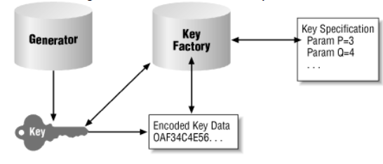
Keys and Certificates (cont.)
Certificates are used to authenticate public keys.
When public keys are transmitted they are embedded within certificates.

Slide 40
Keys and Certificates (cont.)
A generator class creates keys from scratch.
Symmetric keys are generated by the KeyGenerator class.
Assymetric key pairs are generated by the KeyPairGenerator class.
The KeyFactory class translates between key objects and their external representations.

Slide 41
Keys and Certificates (cont.)
The java.security.Key class represents a single key.
Because keys must be transferred to and from various entities they must be serializable.
The key returns the algoritm used to generated the key, the format and the encoded byte[] array.
The java.security.PublicKey and java.security.PrivateKey classes extends the Key class.

Slide 42
Keys and Certificates (cont.)
java.security.interfaces.DAParams retrieves the DSA algorithm specific parameters: P, Q and G used to generated the keys.
Keys that are generated by DSA will typically implement the DSAKey interface.
The DSAPrivateKey and DSAPublicKey extends DSAKey interface.
The KeyPair class contains the public and private keys.
The javax.crypyo.SecretKey extends the Key class.
Secret key types: Blowfish, DES, DESede, HmacMD5,HmacSHA1, PBEWithMD5AndDES, and PBEWithMD5AndTripleDES.

Slide 43
Keys and Certificates (cont.)
The java.security.KeyPairGenerator class can be used to generate a pair of asymmetric keys.
The implementation has the algorithm and provider parameters.
The initialize() method initializes the key pair generator to generate keys of the given strengh.
The DSA strength must be between 512 and 1024 and must be multiple of 64.
The RSA strength must be between 512 and 2048.

Slide 44
Keys and Certificates (cont.)
The java.security.cert.Certificate class represents a certificate entity.
To verify that the certificate is valid we need to have the public key of the certificate authority that issued it.
X509 is a certificate format represented in java by the X509Certificate class.

Slide 45
Keys and Certificates (cont.)
Keys are stored to using a key management system.
Keystores are created and manipulated though an administrative tool(keytool) and there is a Java API that allows to use keystore programatically.
Key management terms:
keystore: file that holds set of keys and certificates.
alias: every key in the keystore belongs to an entity.
DN(distinguished name): subset of X.500 name.
key entry: may hold an asymmetric key pair or a single secret key.
certificate entries: contains only a public key certificate.
JKS,JCEJS,PKCS12: different algorithms of keystores.

Slide 46
Keys and Certificates (cont.)
The keytool is an utility for CRUD operations in the keystore.
We can generate keys using bellow command:keytool -genkey -alias test -keyalg RSA
We can generate certicates: keytool -certreq -alias test -file test.cert
We can import certificates: keytool -import -file test.cert -alias test -trustcacerts

Slide 47
Message Digests
Message digests are the simplest of the standard engines.
A secure message digest is called a Message Authentication Code (MAC).
MAC requires a secret key that is shared by the sender and receiver.
Sun's implementation of JCE provides 2 algorithms for calculation MAC: HmacSHA1 and HmacMD5.
We have message diggest streams classes like: java.security.DigestOutputStream and java.security.DigestInputStream.

Slide 48
Cipher Encryption
Cipher based encryption is part of JCE and contains a cipher engine that performs encryption.
The engine class is javax.crypto.Cipher for encryption and decryption.
SunJCE security provider: DES(Data Encryption Standard), DESede(triple-DES), PBEWithMD5AndDES, Blowfish
SunJCE modes: ECB, CBC(cipher block chaining), CFB(cipher-feedback mode), OFB(output-feedback mode), PCBC.
SunJCE padding schemes: PKCS5Padding, NoPadding.

Slide 49
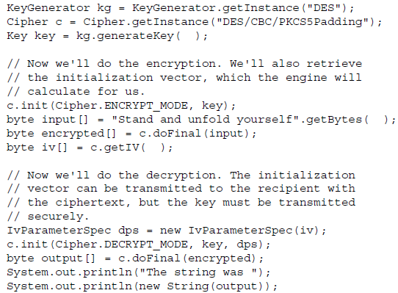
Cipher Encryption (cont.)

Slide 50
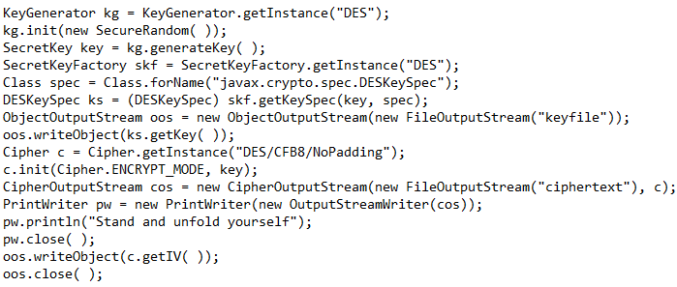
Cipher Encryption (cont.)
The SPI for javax.crypto.Cipher class is the javax.crypto.CipherSpi class.
The class is responsable for performing the encryption or decryption according the the internal algorithm.
Support for various modes or padding schemes must be handled by this class.
Classes like javax.crypto.CipherOutputStream or javax.crypto.CipherInputStream have the abbility to associate a cipher object with and input or output stream.

Slide 51
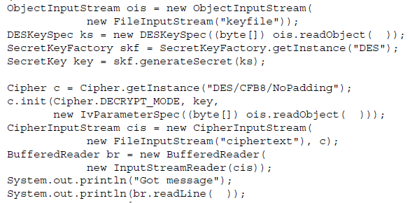
Cipher Encryption (cont.)
Bellow is an example of decryption:

Slide 52
SSL and HTTPS
Java Secure Socket Extension (JSSE) is used to perform SSL encryption.
SSL provides data encryption over TCP sockets and is the basis for HTTPS protocol.
JSSE deinfes an API for SSL sockets.
JSSE supports only SSL 3.0 and TLS 1.0.

Slide 53
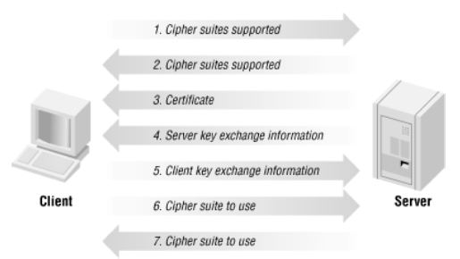
SSL and HTTPS (cont.)
The SSL protocol exchanges information between the client and server, process called SSL handshake.

Slide 54
SSL and HTTPS (cont.)
SSL handshake flow:
1. Clients initiates the connection to the server and tells the server which SSL sipher suite the client supports.
2. The server responds with the cipher suites that it supports.
3. The server sends the client a certificate that verifies its identity.
4. The server initiates a key exchange algorithm ands sends the key to the client.
5. The client completes the key exchange algorithm ands sends the key to the server.
6. Based on the type of key exchange algorithm the client selects an appropiate cipher suite and tells the server which suite to use.
7. The server makes a final decision as to which cipher suite to use.

Slide 55
SSL and HTTPS (cont.)
Once the SSL handshake has been done the client and server can communicate normally with encrypted information.
A trustore represents a databases that holds certificates.
In fact, a trustore has exactly the same format as keysore.
Both are administered with keytool and both are represented programmatically as instances of the KeyStore class.

Slide 56
SSL and HTTPS (cont.)
The server in an SSL conversation must have a private key and a certificate that verifies its identity.
SSL servers can require that the client authenticate itself as well.
In this case the client must have its own keystore with a private key and certificate.
Keystores are used to provide credentials, while truststores are used to verify credentials.

Slide 57
SSL and HTTPS (cont.)
Keystores and truststores are managed programmatically by classes that implement the KeyManager and TrustManager interface.
The default trust manager is looking for certificates into $JREHOME/lib/sercurity/jssecacarts.
If the file doesn't exists it will look to $JREHOME/lib/security/cacerts.

Slide 58
SSL and HTTPS (cont.)
JSSE API defines a set of factory classes to create sockets, independent of SSL.
The javax.net package defines 2 types of factories: javax.net.SocketFactory and javax.net.ServerSocketFactory.
SSL server sockets are obtained through the SSLServerSocketFactory.
The getDefault() method returns the default SSL server factory implementation.
The factory can be used to obtain SSL server sockets.
The default implementation is defined in the $JREHOME/lib/security/java.sercurity file by the ssl.ServerSocketFactory.provider property.

Slide 59
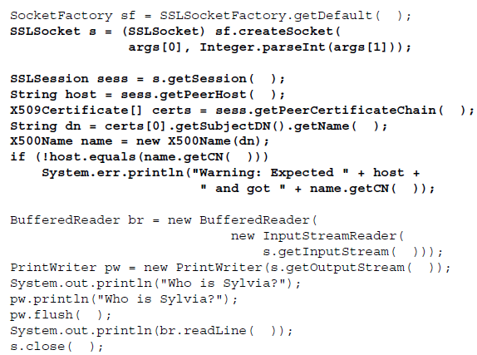
SSL and HTTPS (cont.)
When an SSL socket is connected it will join a SSL session.
When we create a SSL connection we can verify the server information using the session.
The SSL session is represented by the javax.net.ssl.SSLSession interface.

Slide 60
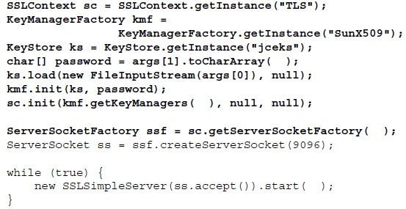
SSL and HTTPS (cont.)
The generic SSL sockets uses default options(like TLS 1.0) and the default key and trust managers.
If we need to change the default options we need to use the SSLContext class.

Slide 61
JAAS
JAAS(Java Authentication and Authorization Service) provides a framework to check explicit permission when executing certain operations.
JAAS provides a set of classes thatn authenticate a user.
JAAS also provides a set of classes that authorize users to perform operations.

Slide 62

Bibliography
O'Reilly – Java Security Second Edition

